Slide 1
INTRODUCTION
PRINCIPLES OF OPERATIVE SURGERY
Prepared by
Dr. Panchajani. R

Slide 2
TECHNICAL TERMS USED IN SURGERY
SEPSIS
ASEPSIS
PATHOGENS
PATHOGENESIS.
TOMY- incision or cutting
STOMY- creation of an opening into a cavity but opening to the exterior is maintained
ECTOMY – excision or surgical removal
ENUCLEATION- removal of an organ or mass intact from the supporting tissues
PLASTY- formation or repair of a structure
RADICAL- directed to the root or cause, elimination of all possible extension.
LIGATION- tying of a blood vessels or a pedicle.
Suturing – stitching together of the edges of a surgical or traumatic wound
Antiseptic surgery- bacteria is killed by an antiseptic .
Aseptic surgery- sterilization of each and every instrument which come in contact with the wound

Slide 3
OPERATION THEATRE DISCIPLINE
AIM- TO PREVENT POST OPERATIVE INFECTION
ASEPSIS
HAND DISINFECTION
OPERATING ROOMS DISINFECTION
SURGICAL PROCEDURES

Slide 4
OPERATION THEATRE DISCIPLINES
ENTRY- Remove shoes
GOWNS- Sterile
MASKS- Face masks( disposable)
PROTECTIVE EYE WEAR
HAIR & BEARD COVER- Hair cap
FOOT WEAR
GLOVES
PROTECTIVE CLOTHINGS
VISITORS

Slide 5
STERILIZATION & Disinfection
Sterilization – is distruction of all living organisms .
Disinfection is the reduction of a population of micro organisms with out achieving sterility.
Aim is sterilization not disinfection .
Types –
Chemical S; Done by antiseptic solutions (iodine)
Heat sterilisation ; dry & wet
dry- open flame, hot air ovens( 160degree C )
wet- boiling / steaming
Autoclaving - by a steam at 120 degree celcius of pressure,
choice of regulating tempt, pressure , time , Quick cycle(134degree), slow cycle(115 degree)
Use of centre store supplies facilities (CSS)- cleaned, prepared and packed in sealed envelops.

Slide 6
PREPARATION OF THE SURGEON
HAND WASHING- With soap and water then with skin antiseptics. Dry with sterile towels

Slide 7
Preparation of the patient
CASE TAKING & PHYSICAL EXAM.
VITAL SIGNS
LAB INVESTIGATIONS- Blood , Urine etc..
ORAL HYGIENE.
BOWEL
SEDATION

Slide 8
OPERATING AREA
EXAMINATION
SKIN PREPARATION- beyond the field of operation, Shaving & Washing with soap and water then with antiseptic solution
ANAESTHESIA

Slide 9
ANAESTHESIA A temporary state that causes unconsciousnes, loss of memmory, lack of pain &muscle relaxation.

Slide 10
Anaesthesia
TYPES-
Local- only the part which is to be operated, types - topical, field block, regional nerve block
Spinal- certain area with out making the patient unconscious.
General- patient become unconscious - injectable , inhalation A
PREPARATION ;
EARLY ASSESSMENT & INVESTIGATION OF THE PATIENT
Anaesthetising agents are generally gas or liquid
DOSE OF ANESTHETIC IS SAFE NOT EXCEEDED . DOSE OF DIFFERENT ANESTHETIC AGENT IS DIFFERENT

Slide 11
Local anaesthesia
Types - topical, field block, regional nerve block.
Freezing- ethyl chloride spray , for superficial use , Freezing of overlying skin only.
Topical / Surface A- mucous membrane absorb local A very rapidly, efficiently &painlessly . Onset of A is rapid & last for up to 1 hr .eg. xylocane
Infilteration A - local anesthetic agents can be given by injections .
Epidural A-( regional A)- Blockage of major nerve trunk at the site of Surgery. Slower than S.A. Local anesthetic is introduced through a lumbar puncture type needle in to the extradural space (OBG &general surgeries)
IV regional A- Total anesthesia in an operating field in an arm/ leg
Amnalgesia – awareness of painful stimuli lost but pt. is fully conversant with what is happening . Used in paracenthesis.

Slide 12
Spinal anaesthesia
Intrathecal A
Injected in to the CSF to rapidly produce an intense blockage with in 5 minutes results in hypotension. So IV fluids & vasoconstrictive drugs may need to be given.
If solution is ascend too high severe hypotension & ventilatory failure occurs.this limits its use in surgery below the segmental level of T10.

Slide 13
GENERAL ANAESTHESIA
PROVIDE
Unconsciousness
Pain relief
Muscular relaxation
Maintaining tissue perfusion and oxygenation
Uses a Combination of intravenous drugs and inhaled gases.(anesthetics)
Induced by IV & Maintained by inhaled vapour. (Halothane, enflurane)

Slide 14
G.A
Intravenous faster than inhalation , taking about 10-20 seconds to induce total unconsciousness.
IV induction agents – propofol, sodium thiopental, etomidate, methohexital, ketamine.
Inhalational induction agent - sevoflurane
Duration of action of IV induction agents is 5-10 minutes . In order to prolong unconsciousness anesthesia must be maintained .
Inhaled agents are supplemented by intravenous anesthetics .
Maintenance by allowing the patient to breathe a carefully controlled mixture of oxygen, sometimes nitrous oxide(weak anesthetic), & a volatile anesthetic agent or by administering medication through intravenous catheter.

Slide 15
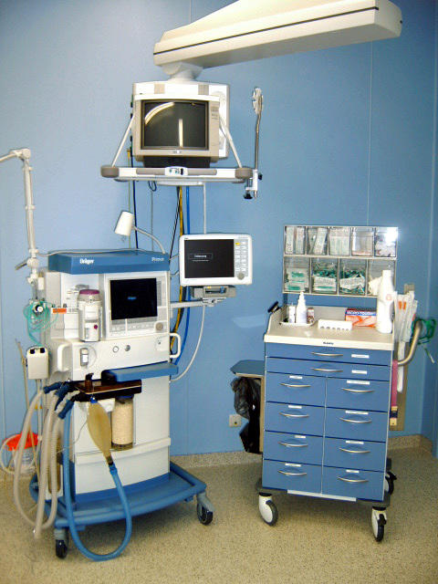
G.A. APPARATUS/BOYLE’S MACHINE

Slide 16
Apparatus
Oxygen Cylinders/ pipeline gas supply- oxygen and/or nitrogen for portable use with the machine .
Reducing valves- open and close during the inspiratory and expiratory cycles to prevent rebreathing of carbon dioxide.
Vaporizers- inhaled agents are inserted in to the machine in liquid form and must be aerosolised for pts. administration .
Flow meters – controls, measures and indicates the rate of flow of gas passing through it.
Carbon dioxide absorber
Ventilators- remove carbon dioxide and deliver oxygen to maintain physiologic homeostasis.
Soda lime canister( mixture of chemicals used in granular form in closed breathing environment )- to remove carbon dioxide from breathing gases to prevent carbon dioxide retension & carbon dioxide poisoning.
Breathing circuites.
Accessories – face masks( Placed on the patients face to supply supplemental oxygen or an inhaled anesthetic ), Laryngoscope, ET tube, metal stylets,
Airway management by ET tube for a fully sedated pt.

Slide 17
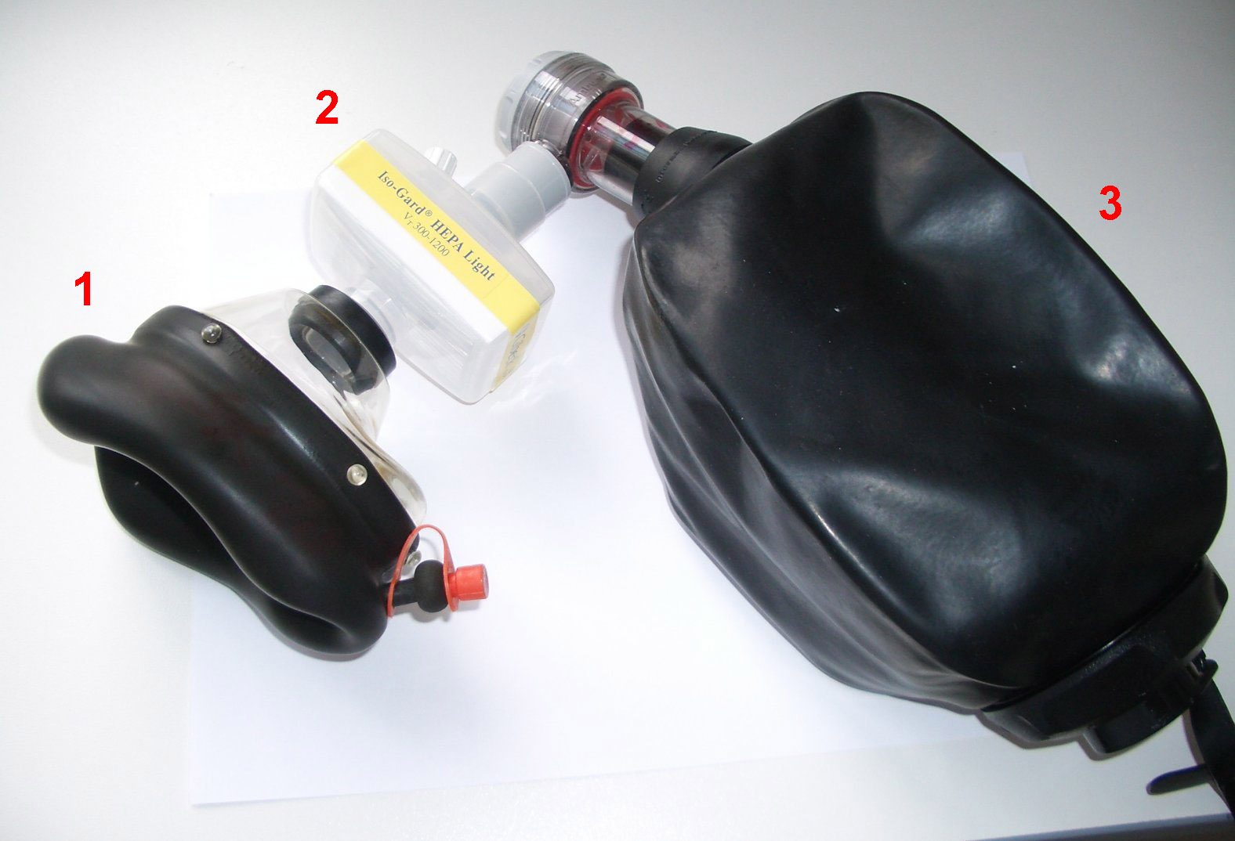
Ambu bag Provide positive pressure ventilation for pts. who are not breathing or not breathing adequately

Slide 18
Monitoring during anesthesia
Vital signs
Blood Pressure
Oxygen concentration/ saturation
Pulse oxymetry- Oxygen( SpO2), Pulse
Carbon dioxide tension- capnography
ECG, EEG
Hourly urine output
Heart rate
Body tempt.
Preservation of Cerebral Perfusion & Oxygenation.

Slide 19
Side effects of G.A
Common- confusion, memmory loss, nausea, vomiting, difficulty to pass urine, dizziness, coldness, sore throat due to breathing tube
Complications of G.A
CNS depression
Coma
Resp. system depression
Hypertension
Morbidity & Mortality

Slide 20
Skin closure
Following operation if skin edges are closely approximated with out tension healing will generally occur in 10 days.
Self adhesive tapes, sterile strips, plaster tape etc.. for small superficial wounds.

Slide 21
SUTURES
The ideal suture is the smallest possible to produce uniform tensile strength, securely hold the wound for the required time for healing, then be absorbed. It should be predictable, easy to handle, produce minimal reaction, and knot securely.

Slide 22
Suturing materials
Surgical suture materials are used in the closure of most wound types. The ideal suture should allow the healing tissue to recover sufficiently to keep the wound closed together once they are removed or absorbed.
The time it takes for a tissue to no longer require support from sutures will vary depending on tissue type:
Days: Muscle, subcutaneous tissue or skin
Weeks to Months: Fascia or tendon
Months to Never: Vascular prosthesis

Slide 23
Suturing materials- Classification
According to absorbability
Absorbable & non absorbable
According to Raw material : Natural& Synthetic
According to Structure : Monofilament,- a single stranded filament suture (e.g nylon, PDS or prolene). They have a lower infection risk but also have a poor knot security and ease of handling.
Multifilament / braided – made of several filaments that are twisted together (e.g braided silk or vicryl). They handle easier and hold their shape for good knot security, yet can harbour infections.

Slide 24
Absorbable sutures
Absorbable Sutures : Lose 50% of breaking strength within 60 days of implanting
Absorbable sutures will eventually dissolve, absorb into the tissue, and become unidentifiable
1.Polyglycolic acid (Safil, Safil Quick, Dexon)
2. Polyglactin 910 (Vicril, Vicryl Rapide)
3. Glycomer (Biosyn)
4. Glyconate (Monosyn)
5. Polyglyconate (Maxon)
6. Polydioxanone (PDS II, MonoPlus)
7. Gut (Cromic Gut, Plain Gut)

Slide 25
Non absorbable sutures
Non-Absorbable Sutures: Retain majority of breaking strength for more than 60 days
Non-absorbable sutures are permanent fixtures in the body and, when properly tied or secured, will remain intact indefinitely.
1. Polyamide (Dafilon , Ethilon, Supramid, Nurolon, Surgilon)
2. Polyester (Ethibond, Ti-Cron, Synthofil, Dagrofil, Mersilene)
3. Polypropylene (Premilene, Prolene)
4. Silk (Silkam, Virgin silk, Mersilk, Softsilk)
5. Nylon
6. Steel (Steelex, Steel wire, Steel)

Slide 26
Suturing materials- classification
Natural Sutures : Sutures made of material that can be found in nature Cause intense inflammatory reaction .Examples : Cat gut, Silk, Steel
Synthetic Sutures: Sutures made of materials created by man Examples : Vicryl, monocryl, PDS, Nylon, Prolene, Polyester
Monofilament Consists of a single strand of material ,passes through tissues easily - less traumatic, Resists bacterial harboring ,require more knots to prevent slippage - 5 or 6 ‘throws’ ,Has more “memory”, Preferred for skin closure because they provide a better cosmetic result .Examples : chromic catgut, plain catgut, stainless steel, prolene, nylon
Multifilament/Braided: consist of several filaments or strands, twisted or braided together .Greater tensile strength ,Pliability and flexibility ,Better knot security ,More tissue trauma ,may harbor bacteria .Examples : vicryl, silk, polyester, nylon.

Slide 27
THREADS
The size-systems of threads:
European Pharmacopeia/Metric units : from 0,1 metric (0,010-0,019 mm) to 10 metric(1,00-1,09 mm)
United States Pharmacopeia USP : from 11/0 (0,010-0,019 mm) to 7 (1,00-1,09 mm)
Smallest size -> 11-0 ,10-0 ,9-0, 8-0, 7-0 ,6-0, 5-0 ,4-0 ,3-0, 2-0 ,0 ,1, 2, 3, 4, 5, 6, 7 <- Largest size
sizes 10-0, 9-0, 8-0 require a microscope
sizes 7-0, 6-0, 5-0 require a magnifying glass
sizes 4-0 and 3-0 do not require magnification
Size 7-0 is almost equal to the thickness of human hair

Slide 28
Threads
Size Uses
7/0 and smaller- Ophthalmology, microsurgery
6/0- Face, blood vessels
5/0- Face, neck, blood vessels
4/0 -Mucosa, neck, hands, limbs, tendons, blood vessels
3/0- Limbs, trunk, gut blood vessels
2/0- Trunk, fascia, viscera, blood vessels
0 and larger -Abdominal wall, fascia, drain sites, arterial lines, orthopaedics.

Slide 29
THREADS
The diameter of the suture will affect its handling properties and tensile strength. The larger the size ascribed to the suture, the smaller the diameter is, for example a 7-0 suture is smaller than a 4-0 suture.
When choosing suture size, the smallest size possible should be chosen, taking into account the natural strength of the tissue.

Slide 30
Threads
Absorbable sutures elicit more inflammatory reaction than non-absorbable sutures
Absorption method :
Natural Sutures - Enzymatic
Synthetic Sutures – Hydrolysis
Natural sutures induce more inflammation than synthetic ones

Slide 31
Threads
Plasticity : Ability to expand when stretched and don’t return to original length (loosen with edema)
Elasticity : Ability to return to its original length after stretching .
High elasticity sutures should be used in oedematous tissue

Slide 32
SUTURES
Fluid absorption and capillary action : the tendency for a suture to absorb water and to wick infection.
Breaking strength rate (BSR) : Approximate days after placement when 50% of breaking strength remains.
Tensile strength : Force necessary to break a suture consider in areas of tension (linea alba)
Knot strength : Force required for a knot to slip consider when ligating arteries
Memory : tendency to return to original shape (untied) ,Tendency to stay in one position, Leads to difficulty in tying sutures

Slide 33
Sutures- threads
Plain catgut / Chromic Gut:
Absorbable – absorbed by body enzymes
Natural
Monofilament
Submucosal or serosal layer of animal intestine
97-98% pure collagen
High tissue reactivity
Tensile strength : 4-5 days (gut) 2 to 3 weeks (chromic gut)
Uses: tubal ligation, ligation of blood vessels, episiotomy repair, closure of peritoneum

Slide 34
Sutures- thread
Poly-sugars:
Absorbable
Dexon, Vicryl, Polysorb
Synthetic polymers with modest tissue reactivity
Tensile strength for 2 to 3 weeks
10% strength at 28 days
Low elasticity - may cut soft tissue
Braided - handle well but wick fluid
Uses: subcuticular closure and fascia
Monocryl Biosyn:
Absorbable
Virtually inert in tissue
Tensile strength for 2 to 3 weeks
Less suture absesses
Uses: mucosa and skin closures

Slide 35
Sutures - thread
Silk:
Non-absorbable
Second only to gut for tissue inflammation
Braided
Best handling of any suture
Lowest tensile strength of any suture
Weaker when wet
Nylon:
•Non-absorbable
•Synthetic
•Mono/multifilament
•Surgilon, Ethilon, Dermalon
•Inert
•Pronounced memory - lots of knots
•Uses: skin closure, sewing in JP draines(jackson- pratt drain for fluid collects under surgical cut)

Slide 36
Sutures-thread
Polypropylene:
Non-absorbable
Synthetic
Monofilament
Prolene, Surgilene, Surgipro
Inert
High plasticity - expands to prevent strangulation, but loosens when edema subsides
Will stretch when pulled
Elastic - requires extra knots
Uses: wound closure

Slide 37
Needle
NEEDLE
Shape of needle :
Curved -Designed to be held with a needle holder , Used for most suturing.
Straight- Often hand held, Used to secure percutaneously placed devices (e.g. central and arterial lines)
Parts of needle :
The eye which is swaged and permits the suture and needle to act as a single unit to decrease trauma
The body which is the widest point of the needle and is also referred to as the grasping area. The body comes in number of shapes (round, oval, rectangular, trapezoid, or side flattened)
The point which runs from the tip to the maximum cross-sectional area of the body. The point also comes in a number of different shapes (conventional cutting, reverse cutting, side cutting, taper cut, taper, blunt)

Slide 38
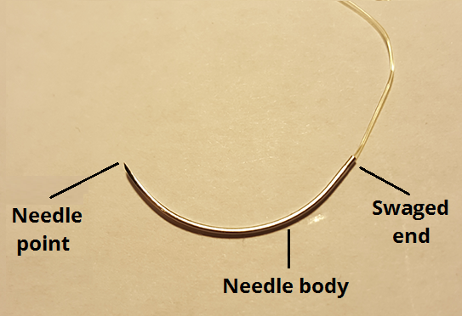
PARTS OF A NEEDLE

Slide 39
Needle
Conventional Cutting Needle:
needle body is triangular and has a sharpened cutting edge on the inside
Triangular tip with the apex forming a cutting surface
Used for tough tissue, such as skin
(use of a tapered needle with skin causes excess trauma because of difficulty in penetration)
Reverse Cutting Needle:
• Similar to a conventional cutting needle except the cutting edge faces down instead of up
• cutting edge is on outer curve
• For tough, difficult-to-penetrate tissues
• This may decrease the likelihood of sutures pulling through soft tissue

Slide 40
Needle
Taper Point Needle :
• needle body is round and tapers smoothly to a point
• cross-section reveals a round, smooth shaft
• no cutting edge
• Used for soft, easily penetrated tissues such as intestine, peritoneum or blood vessels
Blunt Point Needle:
• Taper body
• For blunt dissection and suturing friable tissue such as liver and kidney
Spatula Needle:
• flat on top and bottom
• cutting edge along the front to one side
• Primarily used for eye surgery

Slide 41
Post Operative Complications
Shock
Haemorrhage
Fever
Pulmonary complications
Vomiting
Retention of urine
Abdominal distension
Peritonitis
Paralytic illeus
Intestinal obstruction
Thrombosis
Pulmonary embolism
Wound complications

Slide 42
Reference
Bailey and Love’s short practice of Surgery
Manipal manual of Surgery
SRB’s Manual of surgery
Text book of Surgery- ASI
Clinical Surgery, Das

Slide 43
THANK YOU,
DR. PANCHAJANI.R,
Associate professor,
Dept. of Surgery,
SKHMC

